Slide 1


2023 ICCAD CAD Contest: Problem C: Static IR Drop Estimation Using Machine Learning
Gana Surya Prakash Kadagala and Vidya A. Chhabria
Special thanks to OpenROAD Project (UCSD) and Steel Perlot of support.
Notes:
Hi everyone,
So I will talk about Problem C: Static IR drop estimation using machine learning
First of a special thanks to the OpenROAD Project for supporting a bonus prize money for the contest partcipants and steel perlot for supporting my student who helped with this contest.
Second a big thank you to all the teams who took part and were patient with all the updates to the testcases and through the alpha and beta submission and the participation means a lot..
Thirdly to the contest chairs for being the mediators.

Slide 2
Outline
Introduction:
Power delivery network and its model
Static IR drop and its challenges
Goals and motivation for the contest
The contest
Problem statement
Data and benchmarks
Evaluation criteria
Results

Slide 3
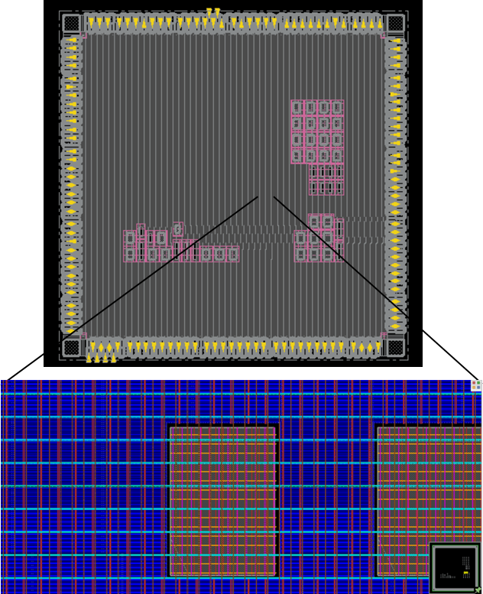
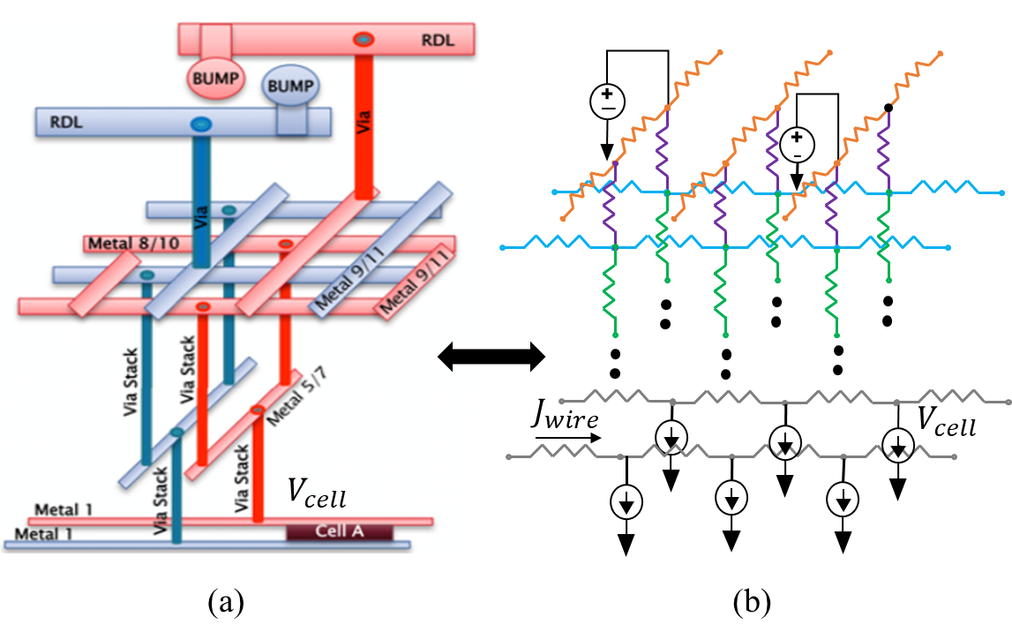
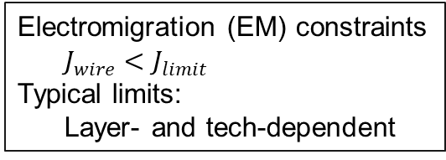
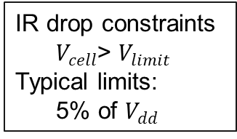
Power delivery network (PDN) and its model
12nm FinFET RISC-V core
IR drop constraints
$V_{cell}$> $V_{limit}$
Typical limits:
5% of $V_{dd}$
Electromigration (EM) constraints
$J_{wire}<$ $J_{limit}$
Typical limits:
Layer- and tech-dependent
Notes:
The static IR drop problem involves analyzing a power delivery network that carries voltage from the outside of the chip to every single transistor.
On the layout, the power grid looks like something shown on the left here, with a bunch of wires patterned in a grid. However, when you examine it in the third dimension, it resembles a set of metal layers carrying voltage from the bump down to every transistor.
The power grid itself can be modeled as a circuit of resistors, voltage sources, and current sources where.
The goal of static IR drop simulation is to check if the power grid is designed correctly. By "correctly," we mean verifying if it meets two constrai

Slide 4
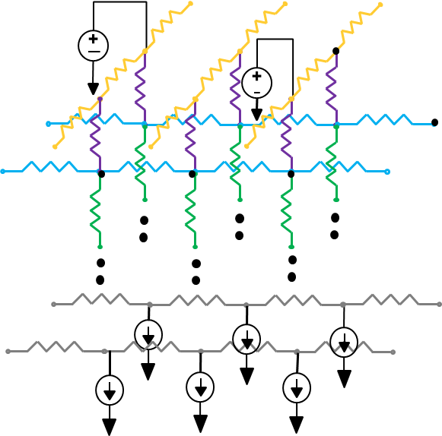
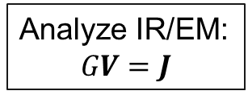
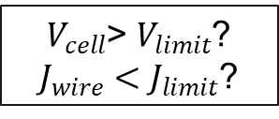
Static IR drop estimation and its challenges
Modified nodal analysis:
Billions of nodes, Problem of “N”
Traditional techniques
Multigrid methods
Sparsity exploitation
Numerical and analytical techniques
Challenge: Computationally expensive
Analyze IR/EM:
$$GV=J$$
$V_{cell}$> $V_{limit}$?
$J_{wire}<$ $J_{limit}$?
12nm FinFET RISC-V core
12M nodes and 3 hours runtime [PDNSim and commercial tool runtimes]
Notes:
So, algorithmically solving for static IR drop amounts to solving this circuit, which, in turn, involves solving a system of linear equations of the form GV=J. It seems simple enough, but it's not quite so. There are billions of nodes in an industry-scale design, which means this G matrix is massive, and solving this system is computationally very expensive.
For example, traditional techniques have attempted to address this by exploiting multi-grid techniques and leveraging sparsity. However, they are still slow to run, making optimization that relies on this analysis under the hood nearly impossible.
12nm FinFET design with 3M nodes takes 3 hours to run static IR drop simulation

Slide 5
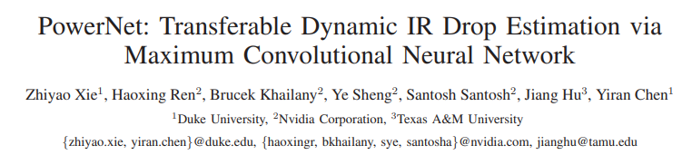
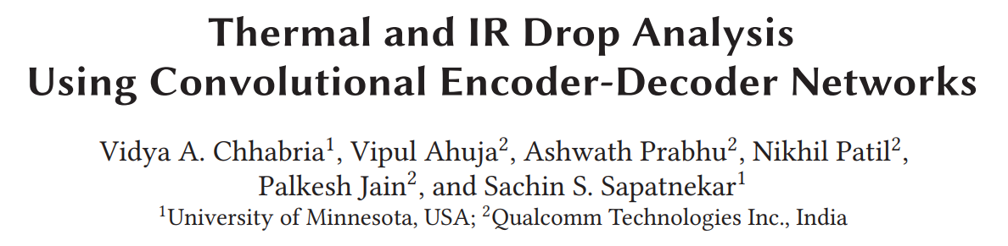
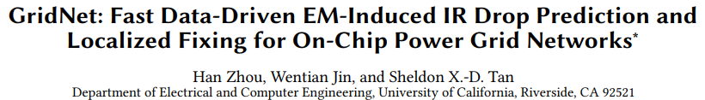
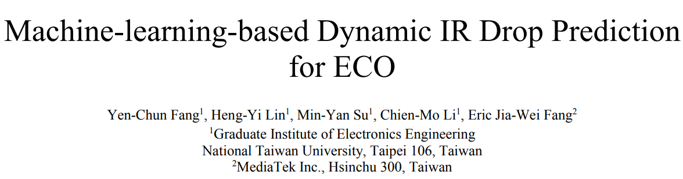
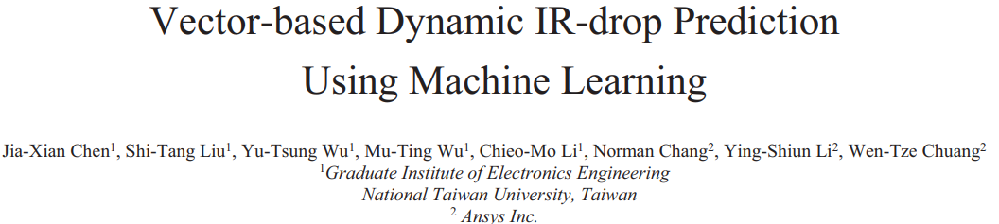
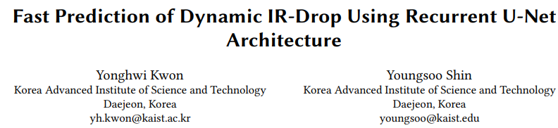
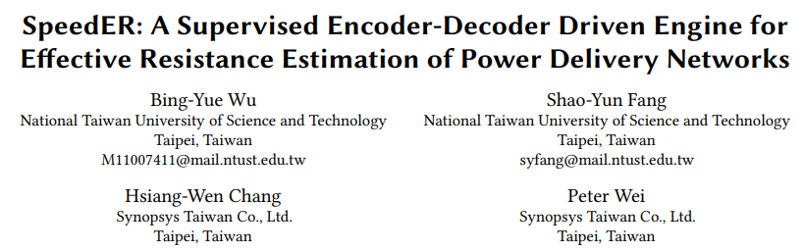
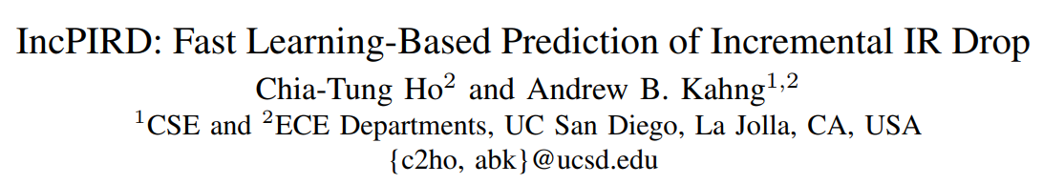
Machine learning to the rescue (?)
Notes:
Since 2019, some machine learning (ML) techniques have been invented to alleviate the issue of long runtimes, albeit at the cost of some accuracy. The slide here displays a very limited selection of papers in this field that have emerged over the past three to four years. These papers demonstrate that ML techniques can accelerate IR drop simulation.
However, you may notice a question mark at the top, because even though each of these works presents innovative algorithms and makes their own comparisons, it's unclear what the current state of the art is. This is due to the fact that these works are not all evaluated on the same set of benchmarks, and they originate from a variety of sources in academia and industry. The industry has access to enough data to train these models but when we create an open-source data set we need large amounts of open data both are hard to come by in EDA.

Slide 6
Motivation and goals for the contest
Apples-to-apples comparisons across different ML techniques
Update existing public domain PDN benchmarks
Previous PDN benchmarks are from IBM, released in 2007/2008
Evaluate the synthetically generated training data as a proxy
Drive innovative feature engineering
Lower the barrier-to-entry to chip design problems through ML
Notes:
That bring me to the goals of this contest:
Apples to apples comparisons. How do we do this?
Updating existing PDN bencharks (few and old)
With open-source data only a limited amount real circuit data. So one of the goals is to see how good we can get with fake data
Drive innovative feature engineering
Lower the barrier to entry to chip design problems through ML

Slide 7
Outline
Introduction:
Power delivery network and its model
Static IR drop and its challenges
Goals and motivation for the contest
The contest
Problem statement
Data and benchmarks
Evaluation criteria
Results

Slide 8
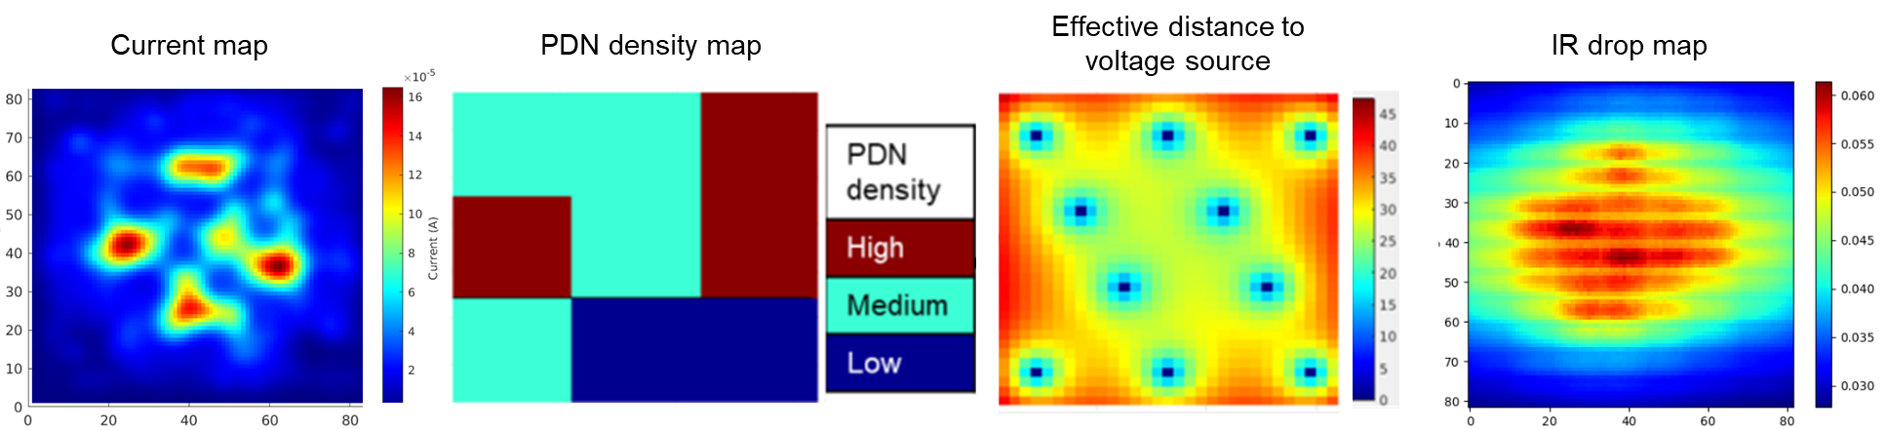
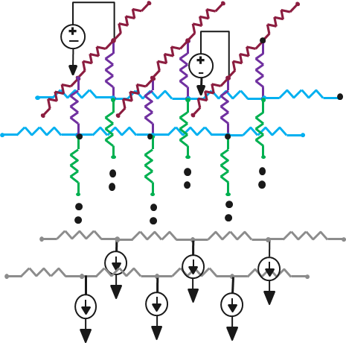
The contest: Problem statement
Contest goal: Predict the IR drop distribution of the chip
Input Option A: Image-based data
Input Option B: SPICE netlist
Required Output
Notes:
For the contest, we provide the benchmarks in two formats. The first format is what is commonly referred to as image-based data. Previous IR drop prediction work has heavily relied on ML papers that utilize images. Another goal in providing these images is to abstract away any EDA tool-related idiosyncrasies. This helps make the problem more accessible to individuals with no background in EDA, thereby reducing entry barriers.
The desired output is the IR drop heat map.
The second input option is a Spice netlist representation of the power grid, along with voltage sources, as depicted on the right here. This option allows participants to apply more complex models, such as GCNs, and delve into the specifics of per-unit resistances, catering to those with a more advanced understanding of both ML and EDA.

Slide 9
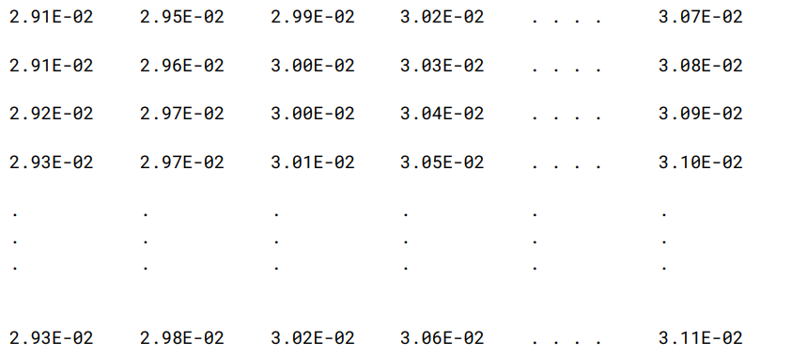
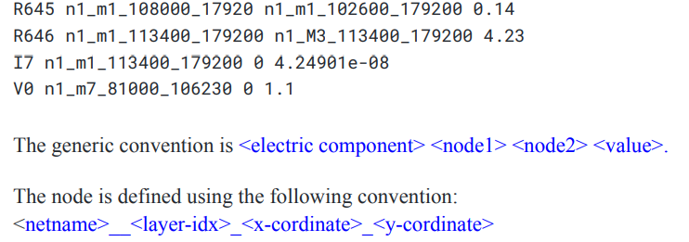
The contest: Data format
Input Option A: Images are in matrix-based CSVs where every pixel represents a 1µm² region on the chip of the three features and the IR drop
Input Option B: SPICE netlist with node coordinate information embedded
Notes:
The data was available in two formats. The image-based data was provided as matrices in CSV files that could be readily imported into Python for the application of image-related algorithms, such as CNNs and Unets.
The other format consisted of a SPICE netlist, where the node names encapsulated the x and y coordinates of the nodes. The SPICE file offered a comprehensive representation of the power delivery network (PDN), including the current sources and voltage sources. Additionally, the image-based representation could be derived from this SPICE data using interpolation methods.

Slide 10
The contest: Benchmarks
Differences between real and fake circuit data
Feature | Real circuit data | Fake circuit data
Power map | OpenROAD-flow-scripts after placement | GAN-based power maps (no design required)
Power delivery network (PDN) | Template-based and regular PDNs in OpenROAD-flow-scripts | Template-based and regular PDNs synthesized in custom python script
Voltage source | Vary voltage source distribution in OpenROAD | Vary voltage source distribution in custom python script
SPICE netlist | Extracted from OpenROAD (PDNSim) | SPICE netlist created using python scripts
IR drop map | SPICE simulation and interpolation | SPICE simulation and interpolation
V. A. Chhabria, K. Kunal, M. Zabihi and S. S. Sapatnekar, "BeGAN: Power Grid Benchmark Generation Using a Process-portable GAN-based Methodology," ICCAD 2021.
Notes:
Furthermore, we released two types of datasets. The first was a real-circuit dataset, which consisted of 20 test cases. Among these, 10 were kept hidden from participants, while the remaining 10 were visible. The real-circuit data was generated from open-source EDA (Electronic Design Automation) flow scripts, at least for the input features. The ground truth for the IR drop was still simulated using SPICE.
The second type of dataset was the fake circuit data. This data was created without any specific circuit designs. In fact, the power maps were generated using Generative Adversarial Networks (GANs) to produce these power heatmaps. Subsequently, we synthesized Power Delivery Networks (PDNs) with varying densities on these heatmaps and adjusted voltage sources to create a proxy or synthetic dataset. The SPICE code was generated through custom Python scripts. The IR drop numbers were still generated with SPICE (even though a custom python-based GV=J solver is available as an option too)

Slide 11
The contest: Benchmarks summary
Real circuit data
Twenty real-circuit testcases: Nangate45 technology nodes
Hidden testcases
Visible testcases
Test case | # V | # R | # I | # Templates | Area (mm²)
7 | 16 | 94,590 | 24,988 | 4 | 0.361
8 | 16 | 89,562 | 24,988 | 1 | 0.361
9 | 36 | 186,291 | 64,064 | 4 | 0.697
10 | 36 | 172,877 | 64,064 | 1 | 0.697
13 | 4 | 17,183 | 11,864 | 3 | 0.066
14 | 4 | 16,535 | 11,864 | 1 | 0.066
15 | 16 | 64,120 | 44,117 | 4 | 0.239
16 | 16 | 59,560 | 44,117 | 1 | 0.239
19 | 36 | 201,902 | 63,347 | 4 | 0.757
20 | 36 | 188,475 | 63,347 | 1 | 0.757
Test case | # V | # R | # I | # Templates | Area (mm²)
1 | 4 | 24,088 | 11599 | 4 | 0.089
2 | 4 | 22,328 | 11599 | 1 | 0.089
3 | 49 | 228440 | 101684 | 4 | 0.865
4 | 49 | 214890 | 101684 | 1 | 0.865
5 | 25 | 110466 | 38934 | 4 | 0.411
6 | 25 | 102526 | 38934 | 1 | 0.411
11 | 4 | 10860 | 7718 | 3 | 0.042
12 | 4 | 10408 | 7718 | 1 | 0.042
17 | 16 | 84045 | 59078 | 4 | 0.320
18 | 16 | 80039 | 59078 | 1 | 0.320
Notes:
Here are some statistics regarding the twenty real circuit images that we released:
The number of resistors in the benchmarks varied, ranging from a few tens of thousands to two hundred thousand. The chip areas also exhibited variability, ranging from tens of square micrometers (um²) to approximately 1 square millimeter (mm²).
The hidden test cases are displayed on the left side, while the visible test cases are shown on the right side.

Slide 12
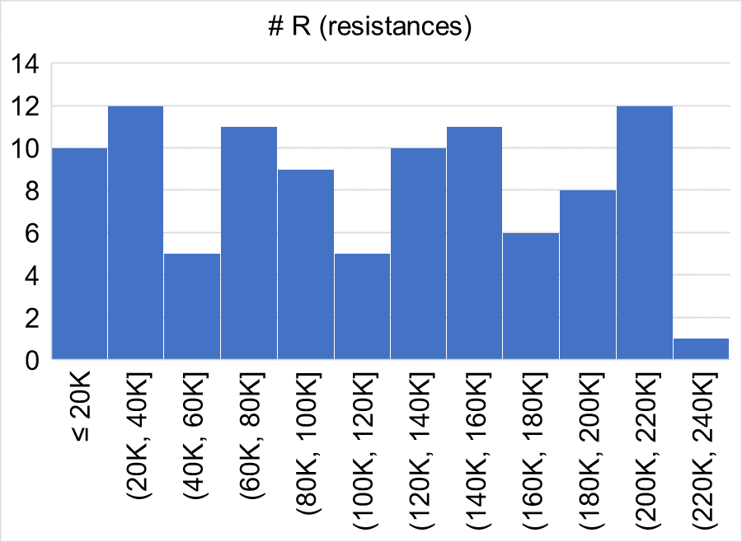
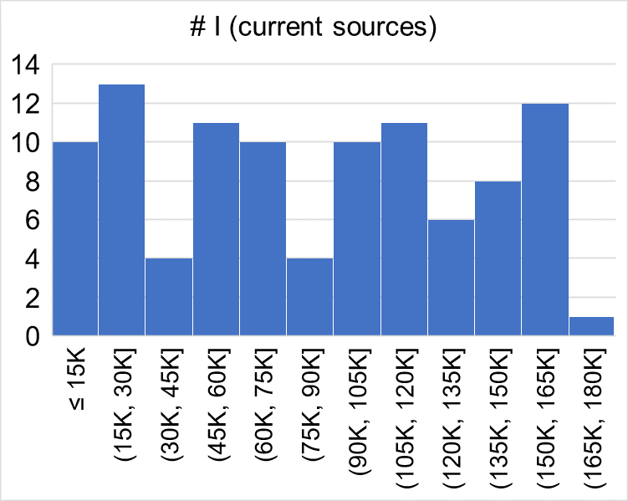
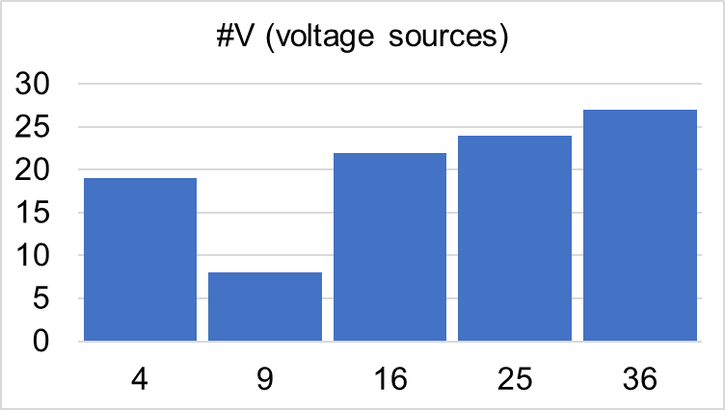
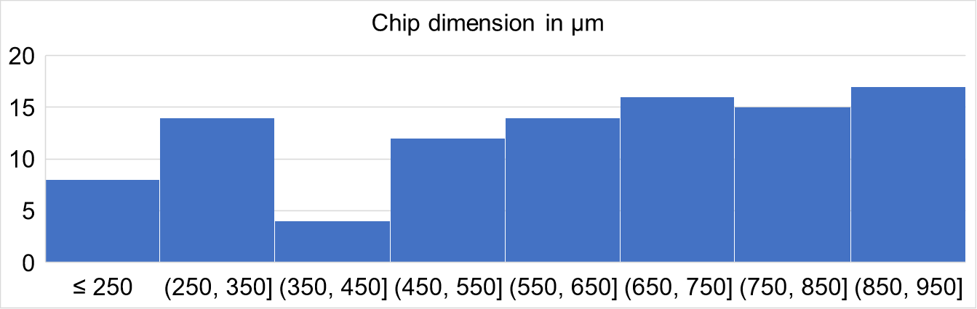
The contest: Benchmarks summary
Fake circuit data
100 data points released for contest
Additional thousands of datapoint on BeGAN repository
Notes:
Here's a summary of the fake circuit dataset:
For the contest, we provided 100 data points sourced from the BeGAN repository as training data. The number of resistors in this dataset ranged from ten thousand to two hundred forty thousand, and the chip sizes were in the hundreds of square micrometers (um²).

Slide 13
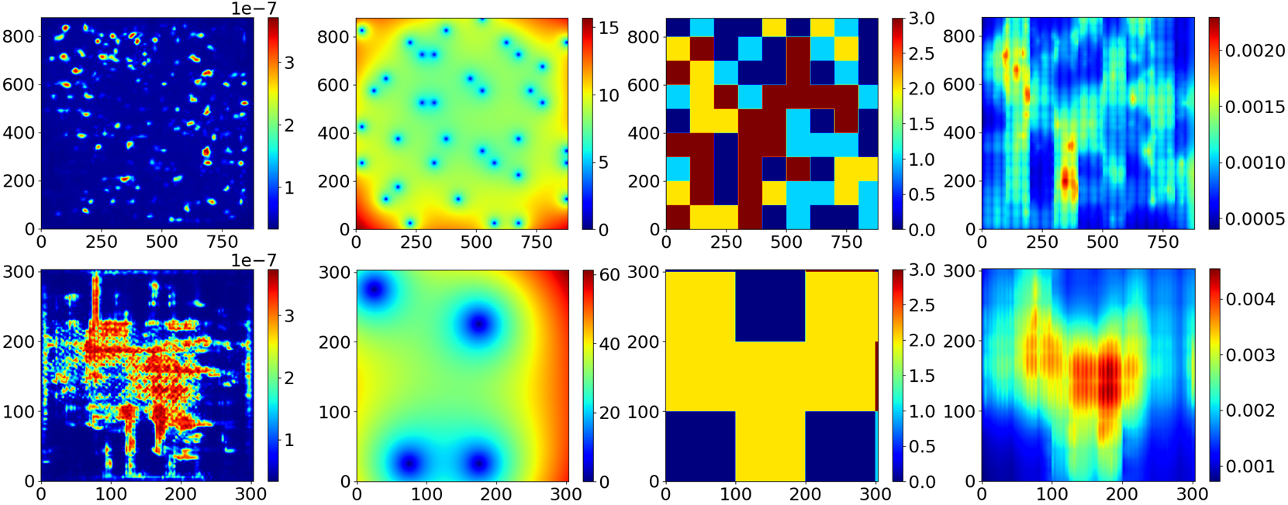
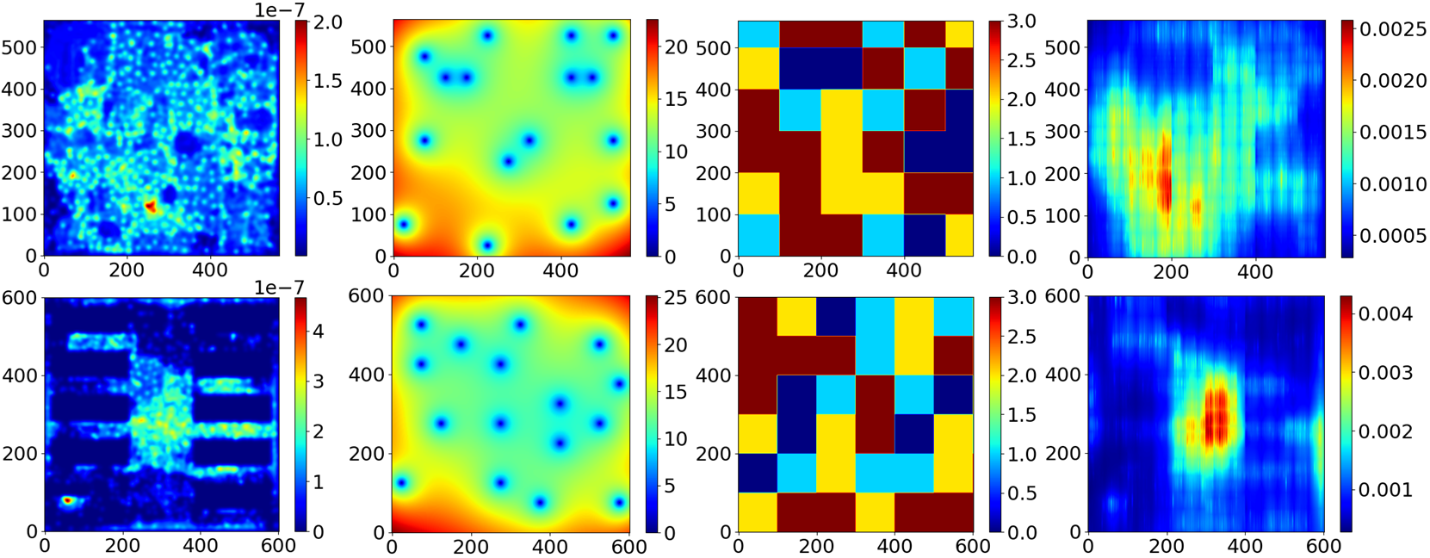
The contest: Example benchmark dataset
Power map
Voltage source
PDN denisty
IR drop map
Fake circuit data
Real circuit data
Notes:
Here are a few example benchmarks in their image based formats that we released. The first two rows here are from the fake datasets. The second two rows are rea circuit data. The columns represent: Power map, Voltage source distributions, PDN density maps, and the SPICE generated IR drop maps with some interpolation.
So there is diversity in each datapoint.

Slide 14
The contest: Evaluation criteria
Mean absolute error (MAE): Element wise differences between predicted IR drop and golden IR drop matrices
F1 score: Binary classification using the 10% of the worst-case IR drop in the golden data as the positive class
F1 score = 2 * Precision * Recall / (Precision + Recall)
Precision = TP / (TP + FP)
Recall = TP / (TP + FN)
Runtime: Inference time for a single datapoint
Total score per testcase: 60% to MAE + 30% to F1 + 10% to Runtime
Team with the least MAE gets 60 points for the testcase, highest F1 score 30 points for the testcase and least runtime get 10 points for the testcase
All other teams scores relative to the maximum metric of the testcase
Notes:
We evaluate performance participant submission using three metrics on hidden testcases:
MAE (Mean Absolute Error): This metric calculates the element-wise difference between the golden and IR drop predicted matrices. It provides a measure of the average absolute difference between the two sets of values.
F1 Score: We convert the prediction problem into a binary classification problem, as circuit designers are often interested in determining if there is an IR drop violation. For each test case, we establish a violation criterion as the top 10% of the maximum IR drop as observed in the golden file. Any IR drop just below this 10% threshold is classified as a violation or hotspot. The F1 score is used as a metric to evaluate how well the model performs in predicting this minority class of true positives.
Runtimes: We also consider the runtimes for each unseen test case as an important aspect of evaluation.
The overall score is a combination of these four metrics with a 60

Slide 15
Outline
Introduction:
Power delivery network and its model
Static IR drop and its challenges
Goals and motivation for the contest
The contest
Problem statement
Data and benchmarks
Evaluation criteria
Results

Slide 16
Results: Number of teams
Total number of teams registered = 72
Number of teams submitted alpha submission = 24
Number of teams submitted beta submission = 25
Number of teams submitted final submission = 27

Slide 17
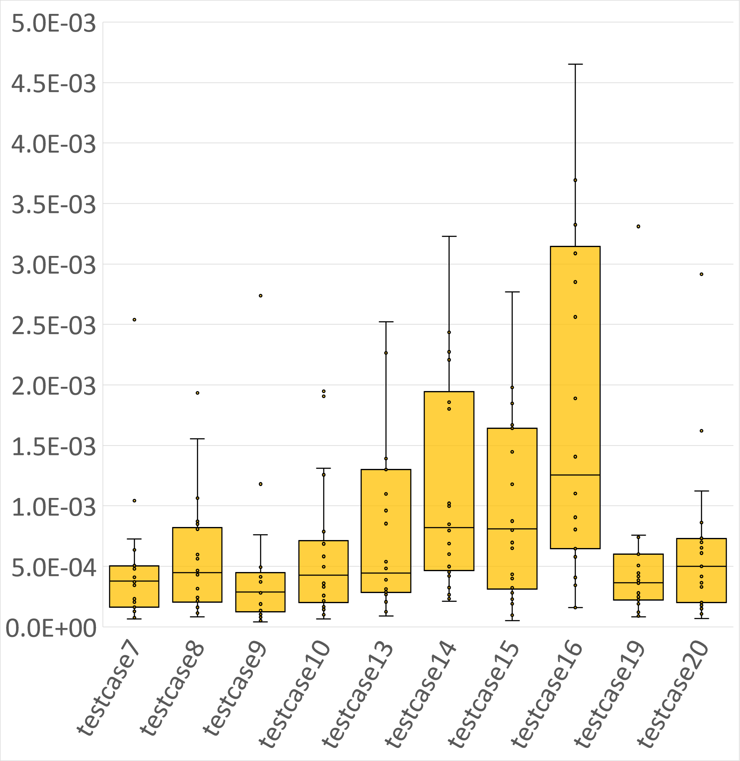
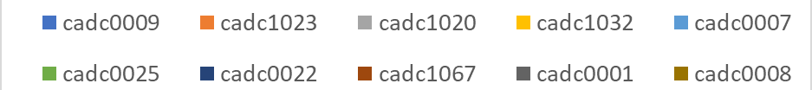
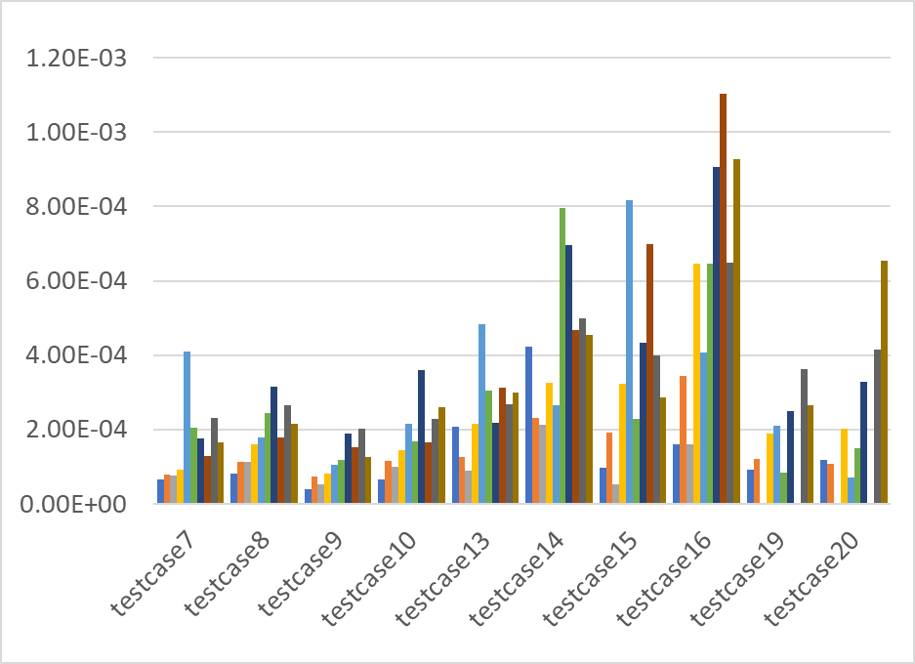
Results: Mean absolute error (MAE)
Top 10 teams MAE in volts and distribution for each hidden real circuit testcase
Notes:
The MAE distribution for each test case for the top 24 teams is displayed on the left side of this slide. On the right side, for the sake of brevity and space, we present the per-team MAE for only the top 10 teams.
It's evident that many teams faced challenges in predicting test cases 14, 15, and 16, as reflected in the large variations in MAE. Test cases 19 and 20 exhibited mixed results, with several teams encountering errors, but those who succeeded achieved good MAE scores.
For those of you in the audience, the right side of the slide allows you to compare your team's performance with other teams for each test case.

Slide 18
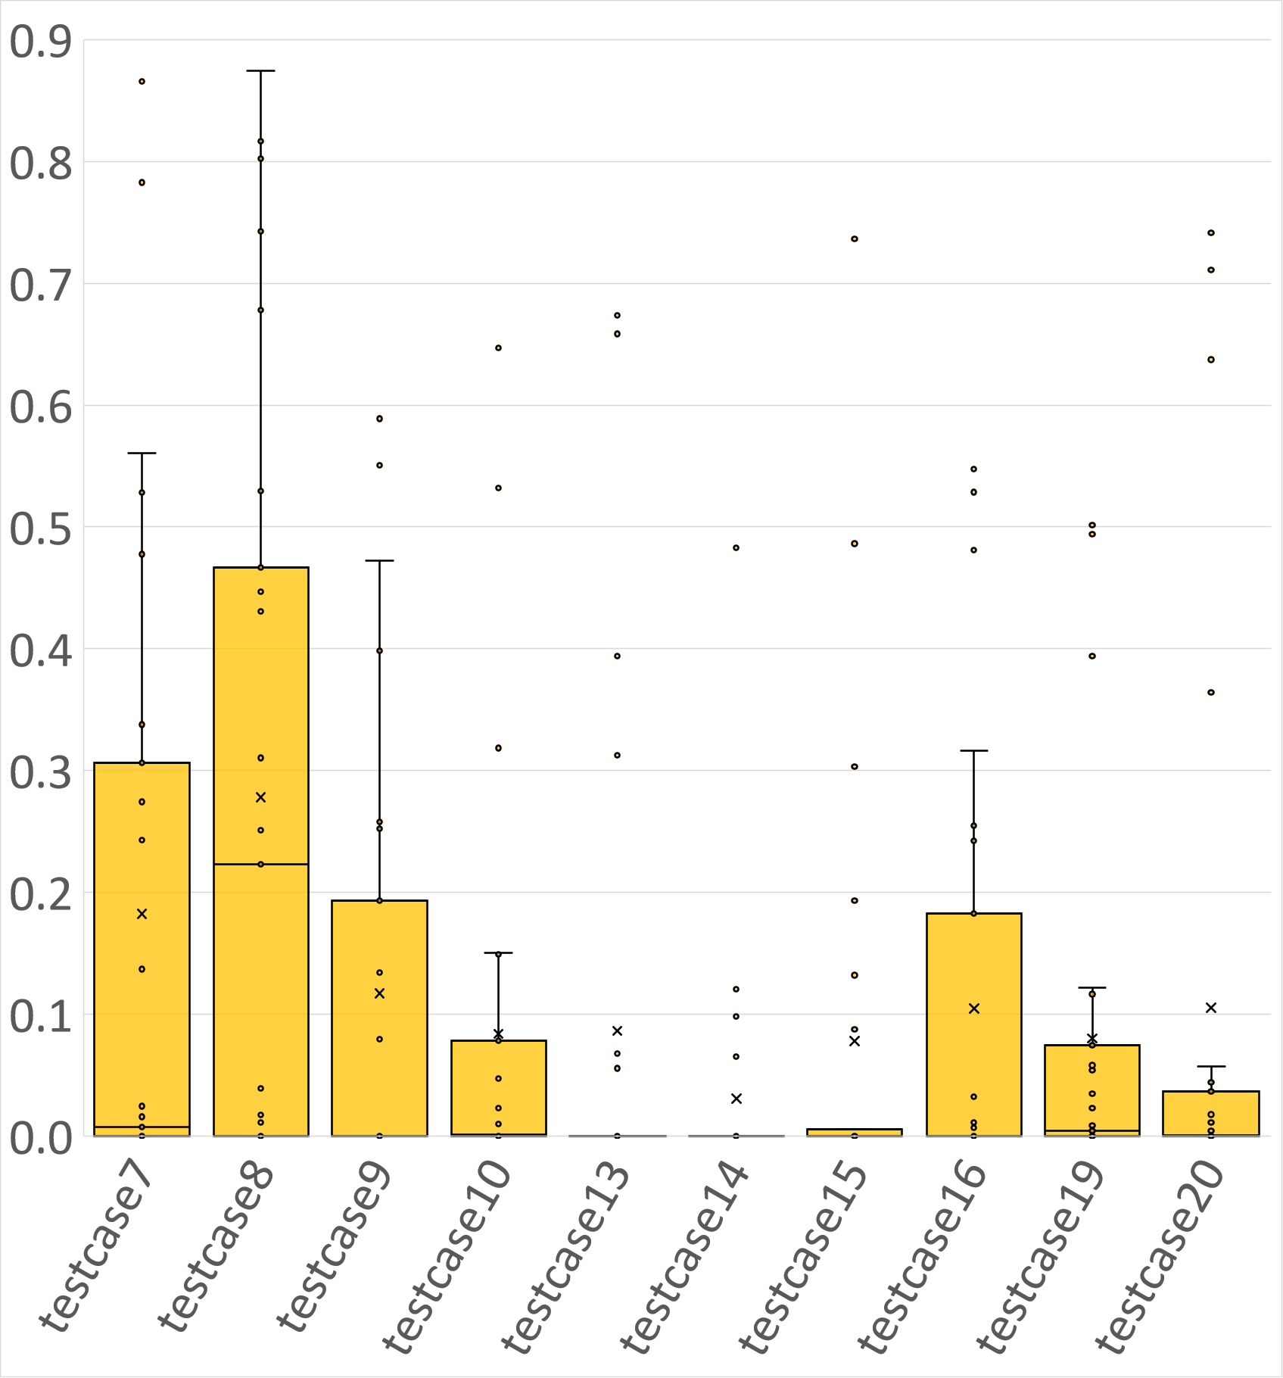
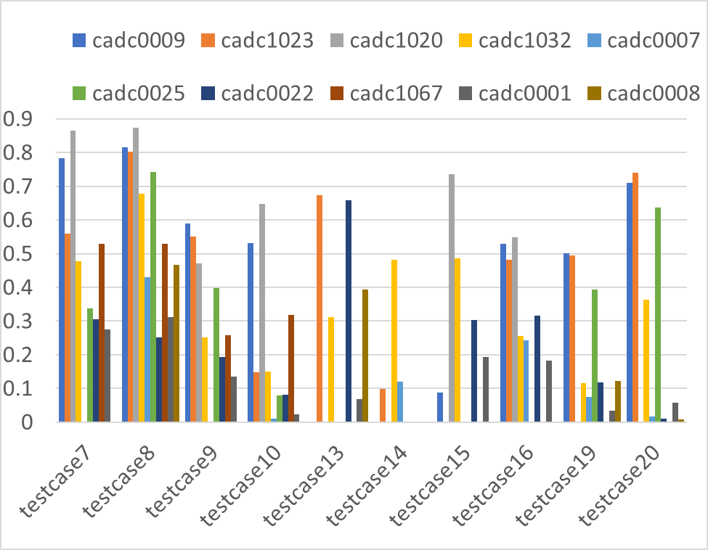
Results: F1 scores
Top 10 teams F1 score and distribution for each hidden real circuit testcase
Notes:
Here is a box plot illustrating the F1 scores. It's evident that for test cases with very high MAEs, the F1 scores were generally quite poor and extremely low. In fact, most F1 scores were low, and this is a common challenge when dealing with supervised training for an imbalanced dataset. It's important to note that this difficulty is generally acceptable given the nature of the problem.

Slide 19
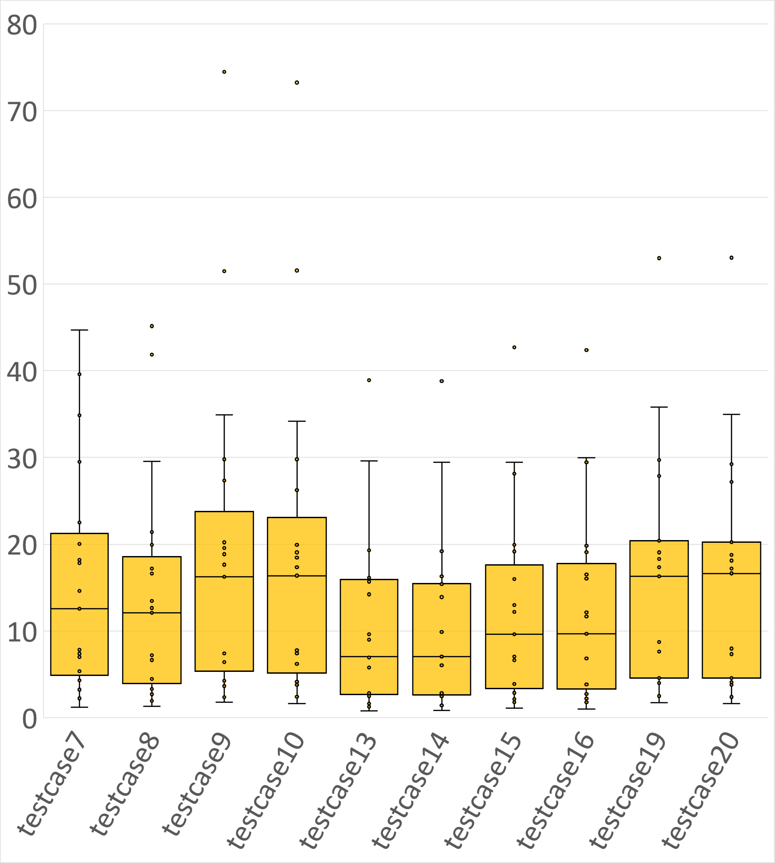
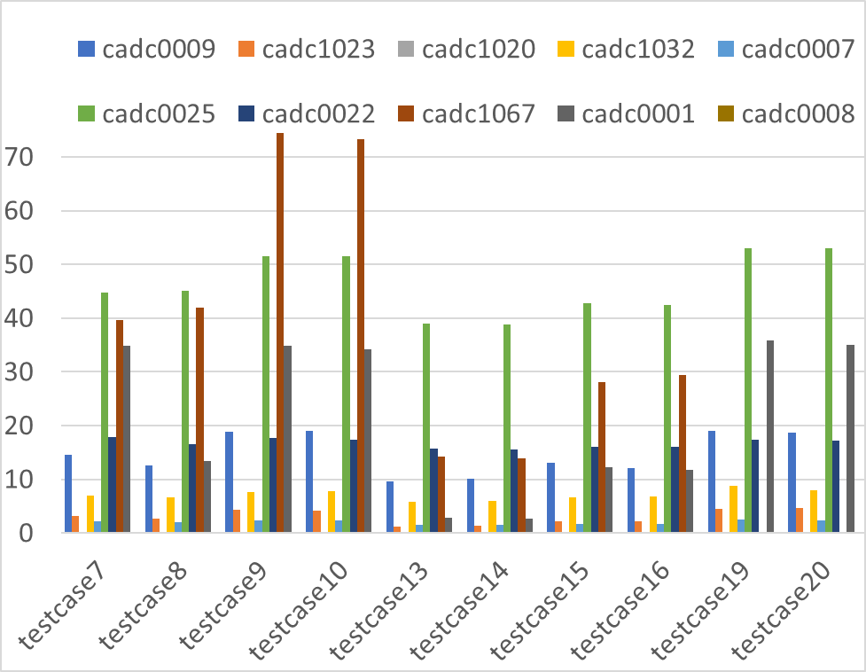
Results: Runtimes
Top 10 teams runtime in seconds and distribution for each testcase
Notes:
On the runtimes side, I think there was overall similar. Ranges from a few seconds to 10s of seconds. I did not notice a lot of interesting take aways here. There were a few challenges with student providing executable versus scripts etc. But we got over it towards the end.

Slide 20
Results: Overall score
Top 10 teams score per testcase and final score
Testcase | Testcase7 | Testcase 8 | Testcase9 | Testcase10 | Testcase13 | Testcase14 | Testcase15 | Testcase16 | Testcase19 | Testcase20 | Final score | Rank
cadc0009 | 87.94 | 89.05 | 90.93 | 85.53 | 26.98 | 30.92 | 36.69 | 89.78 | 85.83 | 65.20 | 688.84 | 1
cadc1023 | 73.76 | 75.55 | 65.65 | 45.49 | 79.43 | 66.66 | 21.26 | 58.87 | 74.69 | 72.83 | 634.19 | 2
cadc1020 | 82.54 | 72.86 | 71.60 | 69.46 | 60.00 | 60.00 | 90.00 | 89.71 | 0.00 | 0.00 | 596.17 | 3
cadc1032 | 61.36 | 55.54 | 45.37 | 36.51 | 40.45 | 70.38 | 31.10 | 30.30 | 35.08 | 37.58 | 443.65 | 4
cadc0007 | 14.91 | 49.02 | 30.80 | 25.62 | 16.15 | 60.48 | 9.87 | 42.54 | 34.89 | 67.61 | 351.88 | 5
cadc0025 | 31.07 | 45.85 | 41.22 | 27.67 | 17.99 | 16.16 | 13.87 | 15.09 | 83.90 | 53.94 | 346.76 | 6
cadc0022 | 33.69 | 24.89 | 23.71 | 15.69 | 54.77 | 18.79 | 20.24 | 28.54 | 28.09 | 14.14 | 262.56 | 7
cadc1067 | 49.43 | 46.01 | 29.26 | 38.99 | 17.89 | 27.71 | 4.86 | 9.05 | 0.00 | 0.00 | 223.19 | 8
cadc0001 | 26.87 | 30.19 | 19.32 | 18.86 | 26.04 | 28.42 | 16.60 | 25.69 | 16.25 | 12.86 | 221.10 | 9
cadc0008 | 23.90 | 38.78 | 19.37 | 15.27 | 35.59 | 27.99 | 10.89 | 10.36 | 26.07 | 6.72 | 214.94 | 10
Notes:
Here is the final score. It’s a table that has a lot of numbers and may not be very readable. However, I just want to mention that each testcase is graded out of 100.Since there are 10 testcases, the best score each team can get is a thousand. This table is sorted in terms of the final score.
The top four teams are highlighted.
The teams did a great job overall. A lot of effort was visible while I was evaluating the solutions. Thanks very much.

Slide 21
Conclusion
The contest had 27 final submissions
Innovative solutions with novel feature engineering techniques from participants resulting in high F1 and low MAE values
Release of synthetic benchmarks and real circuit benchmarks:
ICCAD Contest benchmarks and benchmark generation scripts: https://github.com/ASU-VDA-Lab/ML-for-IR-drop
Additional BeGAN benchmarks: https://github.com/UMN-EDA/BeGAN-benchmarks
Notes:
One last point is that the benchmarks the hidden and visible. The data generation scripts are available on this repository. For more benchmarks in different technology nodes they are available on the BeGAN repo.

Slide 22
Winners!

Slide 23
ICCAD23 Problem C: Static IR drop prediction using machine learning
Third place: Congratulations!
Problem C |  | Contributing authors | School
3rd Place | Advisors | Prof. Roman Solovyev | Institute for Design Problems in Microelectronics of Russian Academy of Sciences
 |  | Prof. Dmitry Telpukhov | National Research University of Electronic Technology
 | Students | Ilya Shafeev | National Research University of Electronic Technology
 |  | Evgeny Demidov | Institute for Design Problems in Microelectronics of Russian Academy of Sciences

Slide 24
ICCAD23 Problem C: Static IR drop prediction using machine learning
Second place: Congratulations!
Problem C |  | Contributing authors | School
2nd Place | Advisors | Prof. Zhifeng Lin | Fuzhou University
 |  | Prof. Jianli Chen | Fudan University
 |  | Prof. Jun Yu | Fudan University
 | Students | Yilu Chen | Fuzhou University
 |  | Min Wei | Fudan University
 |  | Xingyu Tong | Fudan University
 |  | Zhijie Cai | Fudan University
 |  | Guohao Chen | Fudan University

Slide 25
ICCAD23 Problem C: Static IR drop prediction using machine learning
First place: Congratulations!
Problem C |  | Contributing authors | School
1st Place | Advisors | Prof. Hung-Ming Chen | National Yang Ming Chiao Tung University
 | Students | Yu-Tung Liu | National Yang Ming Chiao Tung University
 |  | Yu-Hao Cheng | National Yang Ming Chiao Tung University
 |  | Shao-Yu Wu | National Yang Ming Chiao Tung University

Slide 26
ICCAD23 Problem C: Static IR drop prediction using machine learning
Honorable mention: Congratulations!
Problem C |  | Contributing authors | School
Honorable Mention | Advisors | Prof. Zhaori Bi | Fudan University
 | Students | Yuan Meng | Fudan University
 |  | Ruiyu Lv | Fudan University
 |  | Wangzhen Li | Fudan University
 |  | Aidong Zhao | Fudan University

